Slide 1
PC2232-Supplementary Notes
Topic: Gauss’s Law
Sow Chorng Haur
Blk S12, 02-15 or Blk S11 02-07
Email: physowch@nus.edu.sg

Slide 2
Gauss’s Law
Gauss’s Law states that the net flux through any closed surface is
Φ_{E} =
E . dA
= q_{in} / ε_{ο}
Where q_{in} represents the net charge inside the surface and E represents the electric field at any point on the surface.

Slide 3
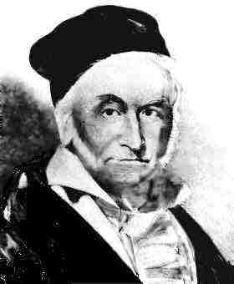
Karl Friedrich Gauss
German mathematician and astronomer (1777-1855)
Picture from http://www.english.upenn.edu/~jlynch/Frank/People/gauss.html

Slide 4
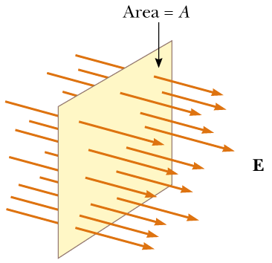
Electric Flux
Magnitude of electric field is proportional to the number of line per unit area (I.e. line density).
The product of the magnitude of the electric field and surface area A perpendicular to the field is called the electric flux Φ_{E} = EA.
SI unit (Nm²/C)
Field lines representing a uniform electric field penetrating a plane of area A perpendicular to the field. The electric flux Φ_{E} through this area is equal to EA.
Pictures from Serway & Beichner

Slide 5
Electric Flux Through a Sphere
What is the electric flux through a sphere that has a radius of 1.00 m and carries a charge of +1.00 μC at its center?
Magnitude of E 1.00 m from this charge is given by
E = kq/r² = (8.99 x 10⁹ Nm²/C²) 1.00 x 10⁻⁶ C/ (1.00m)²
E = 8.99 x 10³ N/C
The field points radially outward and is therefore everywhere perpendicular to the surface of the sphere.
The flux through the sphere (area A = 4πr² = 12.6 m²) is thus
Φ_{E} = EA. = 8.99 x 10 ³ (N/C) (12.6 m²) = 1.13 x 10 ⁵ N m²/C

Slide 6
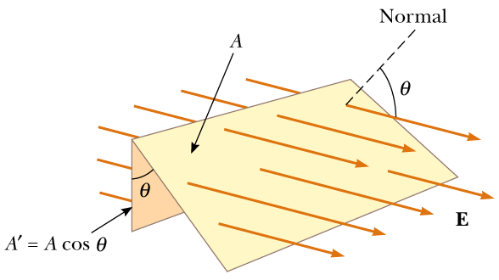
Electric Flux
If surface area under consideration is not perpendicular to the field, it must be projected onto an area that is perpendicular to the flux.
Field lines representing a uniform electric field penetrating an area A that is at angle θ to the field. Because the number of lines that go through the area A’ is the same as the number that go through A, the flux through A’ is equal to the flux through A and is given by Φ_{E} = EA cos(θ).
Pictures from Serway & Beichner

Slide 7
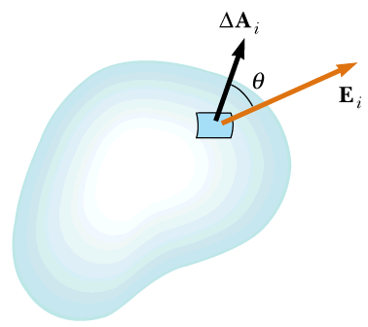
Electric Flux for non uniform electric field
In more general situation, the electric field may vary over a surface. In this case, our definition of flux Φ=EA has meaning only over a small element of area.
Here is what we do: divide a general surface into large number of small elements, each of area ΔA. The variation in the electric field over one element can be neglected if the element is sufficiently small.
It is convenient to defined a vector ΔA_{i} whose magnitude represents the area of the ith element of the surface and whose direction is defined to be perpendicular to the surface element as shown.
A small element of surface area ΔA_{i}. The electric field makes an angle θ with the vector ΔA_{i}, defined as being normal to the surface element, and the flux through the element is equal to E_{i} ΔA_{i} cos(θ).
Pictures from Serway & Beichner

Slide 8
Electric Flux for non uniform electric field (Cont’d)
The electric flux ΔΦ_{E} through this element is
ΔΦ_{E} = E_{i} ΔA_{i} cos(θ) = E_{i} . ΔA_{i} (Dot product of two vectors)
By summing the contributions of all elements, we obtain the total flux through the surface.
If we let the area of each element approach zero, then the number of elements approaches infinity and the sum is replaced by an integral. There fore the general definition of electric flux is
Σ
Φ_{E} =
lim
E_{i} . ΔA_{i}
ΔA_{i}→ 0
i
Φ_{E} =
E . dA
Surface
Pictures from Serway & Beichner

Slide 9
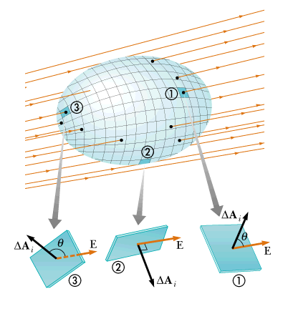
Electric Flux Through Closed Surface
Closed surface is defined as one that divides space into an inside and an outside region, so that one cannot move from one region to the other without crossing the surface. The surface of a sphere, for example is a closed surface.
A closed surface in an electric field. The area vectors are, by convention, normal to the surface and point outward. The flux through an area element can be positive (element 1, zero (element 2), or negative (element 3).
Pictures from Serway & Beichner

Slide 10
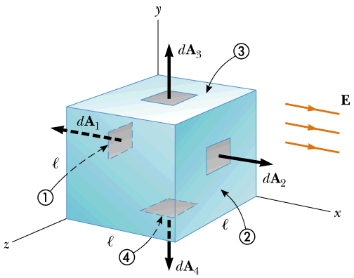
Electric Flux Through a Cube
Consider a uniform electric field E oriented in the x direction. Find the net electric flux through the surface of a cube of edges l, oriented as shown.
6
5
1
2
3
4
5
6
Φ_{E} = -El² +El² + 0 + 0 + 0 + 0 = 0
Pictures from Serway & Beichner

Slide 11
Gauss’s Law
Fundamental importance in the study of electric fields.
It describes a general relationship between the net electric flux through a closed surface. (often called a Gaussian Surface).

Slide 12
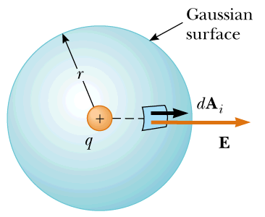
Gauss’s Law (Points Charge)
A spherical gaussian surface of radius r surrounding a point charge q. When the charge is at the center of the sphere, the electric field is everywhere normal to the surface and constant in magnitude.
Consider a positive point charge q located at the center of a sphere of radius r as shown.
Magnitude of electric field everywhere on the surface of the sphere is E = kq/r². The field lines are directed radially outward and hence perpendicular to the surface at every point on the surface.
That is: E . ΔA_{i} = E ΔA_{i}
Pictures from Serway & Beichner

Slide 13
Gauss’s Law (Points Charge)
We find that the net flux through the gaussian surface is
Φ_{E} =
E . dA
=
E dA
=
E dA
Where we have moved E outside of the integral because, by symmetry, E is constant over the surface and given by E = kq/r². Furthermore, because the surface is spherical,
dA = A = 4πr²
Hence the net flux through the gaussian surface is
kq
Φ_{E} =
4π r²= 4π kq = q/ ε_{ο}
r ²

Slide 14
Gauss’s Law
Gauss’s Law states that the net flux through any closed surface is
Φ_{E} =
E . dA
= q_{in} / ε_{ο}
Where q_{in} represents the net charge inside the surface and E represents the electric field at any point on the surface.

Slide 15
Gauss’s Law
Φ_{E} =
E . dA
= q_{in} / ε_{ο}
When using the above equation, you should note that although the charge q_{in} is the net charge inside the gaussian surface, E represents the total electric field, which includes contributions from charges both inside and outside the surface.
Gauss’s law is useful for evaluating E when the charge distribution has high symmetry.
Why is it less useful for evaluating E when the charge distribution does not have high symmetry?

Slide 16
Gauss’s Law
Φ_{E} =
E . dA
= q_{in} / ε_{ο}
In principle, Gauss’s law can be solved for E to determine the electric field due to a system of charges or a continuous distribution of charge.
In practice, this type of solution is applicable only in a limited number of highly symmetrical situation.
If one chooses the gaussian surface surrounding the charge distribution carefully, the integral in above equation can be simplified.
Note that gaussian surface need not coincide with any real physical surface.

Slide 17
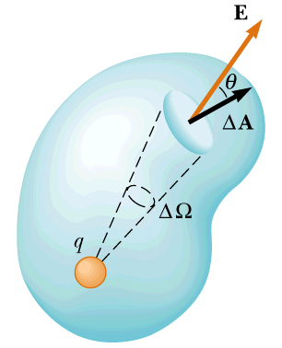
Formal Derivation of Gauss’s Law
Solid Angle ΔΩ (dimensionless unit steradian)
ΔΑ
ΔΩ =
r²
Solid angle subtended by sphere
ΔΩ = 4πr²/r² = 4π steradian
Consider a point charge surrounded by a closed surface of arbitrary shape as shown.
The total electric flux through this surface can be obtained by evaluating E.ΔA for each small area element ΔA and summing over all elements.
Flux through each element ΔΦ_{E} = E . ΔA = EΔAcos(θ) = kq
ΔA cos(θ)
r²
Where r is the distance from the charge to the area element, is the angle between the electric field E and ΔA for the element, and E = kq/r² for the point charge.
Pictures from Serway & Beichner

Slide 18
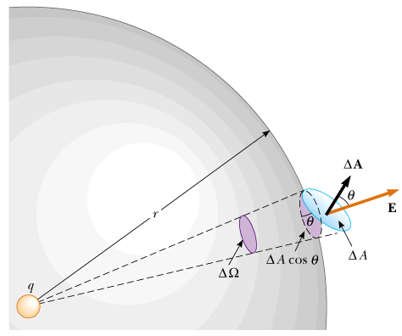
Formal Derivation of Gauss’s Law
In the figure, we see that projection of the area element perpendicular to the radius vector is ΔA cos(θ). Thus the quantity ΔA cos(θ)/r² is equal to the solid angle ΔΩ that the surface element ΔA subtends at the charge q.
We also see that ΔΩ is equal to the solid angle subtended by area element of a spherical surface of radius r. Because the total solid angle at a point is 4π steradians, the total flux through the closed surface is
dA cos(θ)
dΩ
Φ_{E} =
kq
kq
= 4πkq
=
r²
r²
= q / ε_{ο}
Pictures from Serway & Beichner

